Slide 1

SecureOTA
A Secure Heterogeneous OTA Update Mechanism for Resource-Constrained IoT Devices
Department of Cybersecurity Engineering
KCG College of Technology, Chennai
Final year project | Model examination
Presented by Priyankaa Devi S (9123128034) | Rithik Sharma A (9123128040) | Ritesh V (9123128039)
Supervisor [Supervisor name] Project coordinator [Project coordinator name]
Notes:
Introduce the team, supervisor and coordinator. One line on SecureOTA: a firmware update mechanism that keeps updates and device status from being forged, tampered with or replayed, and rejects bad updates cheaply on small microcontrollers.

Slide 2
Table of contents
01
02
03
Abstract
Problem definition
Objectives
04
05
06
Hardware and software
Design diagrams
Implementation
07
08
09
Results and discussion
Conclusion
Future enhancements
10
11
12
Patent / paper
References
Questions

Slide 3
01
Problem and objectives

Slide 4
Abstract
IoT fleets are hard to secure: devices are out of sight after deployment and many update paths never check a signature.
SecureOTA is a firmware lifecycle framework for ESP32, ESP8266, STM32F103 and ATmega328P devices.
Firmware is hashed with SHA-256 and signed with Ed25519 in a GitHub Actions workflow.
Status beacons are encrypted with AES-256-CBC and tagged with HMAC-SHA256 and a persistent counter, so they cannot be forged or replayed.
Five verification gates, ordered by cost and rejection probability, check every update; a health score quarantines failing devices.
86.7%
75 to 77%
invalid packages rejected before the signature gate
less time spent on each invalid package
720
< 2 s
test packages; every genuine one accepted
for a status change to reach the dashboard
Notes:
Problem, three protections, and the headline results (read the four numbers out loud).

Slide 5



Problem definition
Updates and status can be faked
The costly check runs on everything
No view after deployment
Many update paths skip signature checks; plain status messages can be forged or replayed to install old firmware or hide a failed device.
Ed25519 verification is 75 to 78% of total verification time, yet a cheap check would already reject most invalid images.
Operators cannot tell which firmware a node runs or whether an update installed; manual release steps cause mismatches.
Why existing work falls short
Park et al. [5]
Simulated on a laptop; no replay or rollback control
Shin et al. [10]
MQTT, TLS, Merkle tree; no staged rejection or DoS defence
Carnevale et al. [15]
Firmware freshness on a mesh; no timing data or monitoring
Notes:
Three gaps. The middle card is the key insight: the expensive check usually runs on everything, although a 1 ms check would catch most bad packages.

Slide 6





Objectives
01
Authentic, fresh status
Seal beacons with AES-256-CBC, an HMAC-SHA256 tag and a persistent counter.
02
Automated release signing
Sign every build with Ed25519 inside GitHub Actions; no manual release steps.
03
Cheap early rejection
Order five gates by rejection probability per millisecond of cost.
04
Safe install and recovery
Compatibility check, post-boot self-test, rollback and health-score quarantine.
05
Live fleet visibility
Show each device's verified firmware and state on a dashboard within 2 s.
Notes:
Each objective maps to one mechanism shown in the design section.

Slide 7

Hardware and software specification
Layer | Software
Firmware | Arduino-ESP32 2.0.17, PlatformIO / arduino-cli, mbedTLS
Gateway | Python 3.11, FastAPI, Uvicorn, cryptography
Console | Next.js 16, React 19, TypeScript, Tailwind CSS, Clerk
Data | SQLite, JSON gateway state, NeDB, optional Supabase
Flashing | esptool, esptool-js (Web Serial), USB agent
Release, hosting | GitHub Actions, Docker, Cloudflare Tunnel
ESP32
ESP8266
Xtensa LX6 dual-core, 240 MHz
520 KB SRAM, 4 MB flash
Xtensa L106, 80 MHz
about 80 KB user RAM, up to 4 MB flash
ATmega328P
STM32F103
8-bit AVR, 16 MHz
2 KB SRAM, 32 KB flash
Cortex-M3, 72 MHz
20 KB SRAM, 64 to 128 KB flash (planned)
Notes:
Stress the range from 520 KB down to 2 KB of RAM. ESP32 is the demo board; STM32F103 results are planned.

Slide 8
02
System design

Slide 9



6.1 Overall design
Release pipeline
OTA gateway (FastAPI)
Device fleet
Version tag starts build
SHA-256 digest
Signed release bundle
GitHub Releases
Releases, signed manifests
Deployments per device
Device registry, tokens
Beacon check, health score
package
ESP32 node
publish
ESP8266 node
ATmega328P node
beacons
STM32F103 node
REST + live stream
All updates after the first install travel over the air.
Operator console
Live fleet, releases, deployments
USB flash and provisioning (first install)
Notes:
Left to right: the pipeline signs and publishes; the gateway serves signed manifests and packages and receives sealed beacons; devices verify before installing. The console sits on the gateway and is used once per board for USB flashing and provisioning.

Slide 10
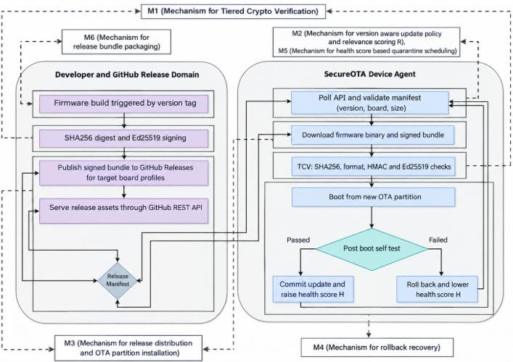
6.2 Detailed design
M1
Tiered Crypto Verification
five gates, cheapest first
M2
Version-aware policy
version check, relevance score R
M3
Distribution and install
delivery, OTA partition write
M4
Rollback recovery
failed self-test restores old image
M5
Health-score quarantine
low H stops updates
M6
Bundle packaging
binary, digest, signature, tag, manifest
Firmware lifecycle, from tagged build to rollback recovery (paper, Fig. 1)
Notes:
Figure 1 of the paper: two domains. The device polls, validates, downloads, runs the five TCV checks, boots the new partition and self-tests; pass commits and raises H, fail rolls back and lowers H. M1 to M6 are the implemented modules.

Slide 11
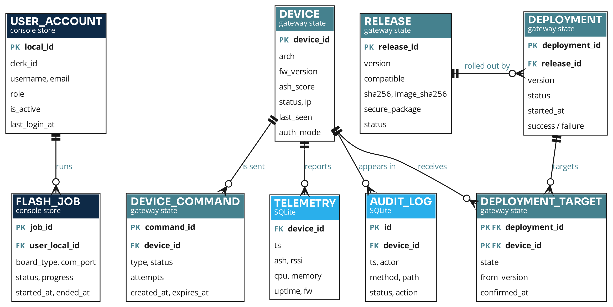
6.3 Database design: ER diagram
Notation || exactly one o< zero or many PK primary key FK foreign key
Notes:
Crow's foot ER diagram. Gateway state holds devices, releases, deployments, deployment targets and commands; SQLite holds telemetry and the audit log; the console store holds user accounts and USB flash jobs. DEPLOYMENT_TARGET resolves the many-to-many between deployments and devices.

Slide 12
6.4 Algorithm design: TCV
G1
1.2 ms
G2
11.8 ms
G3
0.9 ms
G4
2.3 ms
G5
47.5 ms
Manifest
SHA-256 digest
Image format
HMAC tag
Ed25519
Any gate fails: reject the package, keep running firmware, lower health score H
All five pass (D = 1)
write image to the OTA partition
Post-boot self-test
pass: commit, raise H | fail: roll back, lower H
Quarantine
H below threshold: stop polling
Install decision D = g1 × g2 × g3 × g4 × g5
Gate priority ρi = qi / ci
Expected cost E[T] = Σ ci × Π(1 − qj), j < i
Health score Hk+1 = min(1, max(0, Hk + α·sk − β·(1 − sk)))
Notes:
Install only when all five gates pass (D = 1). Gate priority is rejection probability divided by cost; Ed25519 proves origin and always goes last. E[T]: later gates only cost time for packages that passed the earlier ones. Health score H rises by alpha on success, falls by beta on failure; below the threshold the device is quarantined.

Slide 13
03
Build and results

Slide 14






Implementation: modules
M6 Bundle packaging
M1 TCV
M2 Version policy
CI and build script sign the image and package binary, digest, signature and manifest.
Firmware runs the gates in order before writing the inactive OTA partition.
Newest compatible release only; downgrades refused; relevance score R.
M3 Distribution
M4 Rollback
M5 Quarantine
Gateway serves manifests and packages and tracks each deployment per device.
New image boots pending; a failed self-test returns to the old partition.
Every outcome updates the health score; low score stops updates.
Notes:
Every mechanism is real code: packaging in the release workflow and build script, verification in the firmware, policy and distribution in the gateway, rollback via dual partitions, health score on device and gateway. Deployments confirm only when the device reports the new version.

Slide 15
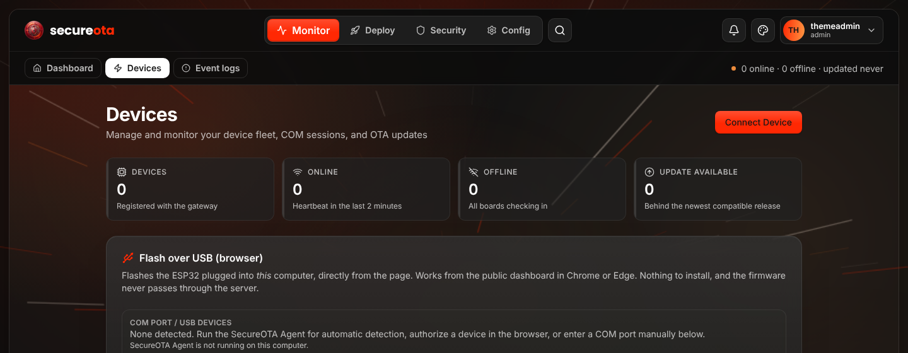




Implementation: platform
1. Build
Full image, signed OTA package, build info
2. First flash
Browser or USB agent; writes Wi-Fi, gateway, token
3. Publish and deploy
Devices update on their next heartbeat
Devices page of the SecureOTA console
Platform security
▪ Per-device tokens, revocable from the console
▪ Roles: admin, operator, viewer
4. Monitor
Status, health score, events, audit log
▪ Audit log of every write request
▪ No private keys in the repository
Notes:
Demo order: build, first flash over USB, publish and deploy, monitor. Mention per-device tokens, roles and the audit log.

Slide 16
Results: gate statistics
312 of 360
invalid packages (86.7%) rejected before the 47.5 ms signature check
Manifest catches wrong board and old versions at 1.2 ms
Digest and format catch altered and malformed images
Only forged signatures reach G5
Every genuine package was accepted
Notes:
360 invalid packages, ESP32. Manifest removes a third at 1.2 ms; digest and format remove most of the rest; only 48 forged signatures reach the 47.5 ms Ed25519 gate. 312 of 360 (86.7%) rejected earlier; no genuine package lost.

Slide 17
Results: verification time
Board | Full | TCV | Saved | Sig.
ESP32 | 63.7 | 16.1 | 74.8% | 74.6%
ESP8266 | 119.2 | 27.9 | 76.6% | 78.2%
ATmega328P | 429.0 | 106.1 | 75.3% | 75.9%
Times in ms per invalid package; Sig. = Ed25519 share of the full pipeline.
Savings stay at 75 to 77% although the boards differ 7 times in speed
Ed25519 is 75 to 78% of the pipeline on every board
Flash cost of the framework: 11 KB to 30 KB
Notes:
Grey: every gate always runs. Green: expected time under TCV ordering. About three quarters saved on every board because Ed25519 is about three quarters of the pipeline everywhere and most bad packages never reach it.

Slide 18
Results: comparison with recent work
 | Carnevale [15] | Shin [10] | Park [5] | SecureOTA
Platform | ESP32 mesh | MQTT, vehicles | Intel i7 laptop | ESP32, ESP8266, ATmega328P
Protection | Key pairing, signature | TLS, Merkle root | Dual XOR, DEFLATE | SHA-256, HMAC, Ed25519
Replay / rollback | Freshness quarantine | Duplicate detection | Not addressed | Persistent counter, version policy
Staged rejection | No | No | No | Yes, 86.7% before signature
Device monitoring | Not stated | No | No | Sealed beacons, under 2 s
Automated signing | No | No | No | GitHub Actions, Ed25519
Notes:
Be fair: each work targets a different setting. Our claim is the combination of staged rejection, authenticated monitoring and automated signing on real microcontrollers.

Slide 19


Conclusion
Trusted updates and status
Cheap rejection
Self-healing fleet
Workflow-bound Ed25519 signing and sealed beacons stop forged and replayed firmware and status.
86.7% of invalid packages dropped before the signature gate; about 75% less time per bad package.
Self-test, rollback and quarantine remove failing devices without an operator.
SecureOTA gives low-cost, mixed IoT hardware verified updates and an authenticated live view of the fleet, for 11 KB to 30 KB of flash.
Notes:
One sentence per card, then the bottom line.

Slide 20
Future enhancements
01
02
03
STM32F103 results
Complete timing and memory evaluation
Key provisioning
Secure first-time keys and rotation
Energy per update
Measure cost on battery nodes
04
05
06
Larger fleets
Noisy, congested wireless links
Adaptive gate order
Re-order gates from live rejection rates
Post-quantum signatures
Alongside Ed25519
Notes:
Six next steps from the paper; the first is the honest gap (STM32F103 measurements), the last is post-quantum signatures.

Slide 21


Patent / paper publications
Conference paper
Patent
SecureOTA: A Secure Heterogeneous OTA Update Mechanism for Resource-Constrained IoT Devices
[Patent status to be confirmed]
Priyankaa Devi S, Rithik Sharma A, Ritesh V and the project guide, KCG College of Technology
Candidate novel elements: the cost-ordered five-gate pipeline (TCV) and the health-score quarantine loop. Check prior disclosure in the paper with the institution before filing.
Item | Detail
Status | Prepared for submission
Target venue | [IEEE conference name, year]
Format | IEEE conference paper, 16 references
Notes:
State the status exactly; replace placeholders once confirmed. Do not claim acceptance or a filed patent unless it has happened.

Slide 22
References (1 of 2)
[1] Noprianto, N. Funabiki, H. H. S. Kyaw, K. C. Brata, I. N. D. Kotama, "A proposal of secure and automated over-the-air firmware update mechanism for IoT devices using CI/CD," Sensors, vol. 26, no. 5, 1535, 2026.
[2] H. S. Mehdy, M. E. Rusli, H. K. Hoomod, "A secured parallel multi-broker MQTT framework with chaos-enhanced hybrid encryption for repetition-resistant IoT security," Computers, vol. 15, no. 10, 650, 2026.
[3] G. Amirkhanova et al., "A lightweight, end-to-end encrypted data pipeline for IIoT: An AES-GCM implementation for ESP32, MQTT, and Raspberry Pi," Information, vol. 17, no. 1, 33, 2026.
[4] W. Y. Leong, "Quantum-resistant encryption for IoT communication in critical engineering infrastructure," Eng. Proc., vol. 134, no. 1, 76, 2026.
[5] C.-Y. Park, S.-J. Lee, I.-G. Lee, "Secure and lightweight firmware over-the-air update mechanism for Internet of Things," Electronics, vol. 14, no. 8, 1583, 2025.
[6] L. Formanek, M. Kubaščík, O. Karpíš, P. Kolok, "Advanced system for remote updates on ESP32-based devices using over-the-air update technology," Computers, vol. 14, no. 12, 531, 2025.
[7] F. Serepas et al., "Lightweight embedded IoT gateway for smart homes based on an ESP32 microcontroller," Computers, vol. 14, no. 9, 391, 2025.
[8] C.-G. Dumitrache, P. Anghelescu, "Design and implementation of a secure communication architecture for IoT devices," J. Sens. Actuator Netw., vol. 14, no. 4, 64, 2025.
Notes:
Do not read these out. Direct comparisons: [5] Park, [10] Shin, [15] Carnevale.

Slide 23
References (2 of 2)
[9] V. P. Ojha, S. Chauhan, S. Yarahmadian, D. Carvalho, "Unfolding post-quantum cryptosystems: CRYSTALS-Dilithium, McEliece, BIKE, and HQC," Mathematics, vol. 13, no. 17, 2841, 2025.
[10] Y. Shin, S. Jeon, "MQTree: Secure OTA protocol using MQTT and MerkleTree," Sensors, vol. 24, no. 5, 1447, 2024.
[11] V. Bhargava, N. S. Raghava, "Version control system gateway to optimize firmware over the air (FOTA) update for IoT wireless devices," Wireless Pers. Commun., vol. 134, no. 1, pp. 249-265, 2024.
[12] C. Silva, V. A. Cunha, J. P. Barraca, R. L. Aguiar, "Analysis of the cryptographic algorithms in IoT communications," Inf. Syst. Front., vol. 26, pp. 1243-1260, 2024.
[13] I. Radhakrishnan, S. Jadon, P. B. Honnavalli, "Efficiency and security evaluation of lightweight cryptographic algorithms for resource-constrained IoT devices," Sensors, vol. 24, no. 12, 4008, 2024.
[14] F. C. Andriulo, M. N. Postorino, "Edge computing and cloud computing for Internet of Things: A review," Informatics, vol. 11, no. 4, 71, 2024.
[15] L. Carnevale et al., "Secure and energy efficient filtered over-the-air Internet of Things setup in a wireless mesh network for firmware freshness," Proc. IEEE BigData, Sorrento, Italy, pp. 3904-3913, 2023.
[16] Z. Dewamuni, B. Shanmugam, S. Azam, S. Thennadil, "Bibliometric analysis of IoT lightweight cryptography," Information, vol. 14, no. 12, 635, 2023.

Slide 24
Thank you!
Questions are welcome
priyankaa786sk@gmail.com
a.rithiksharma@gmail.com
v.riteshvijaykumar@gmail.com
Notes:
Thank the panel and invite questions.

